Slide 1


Securely Inferencing Models with APIs
Ben Coleman
Senior Cloud Architect & Engineer
@BenCodeGeek

Slide 2





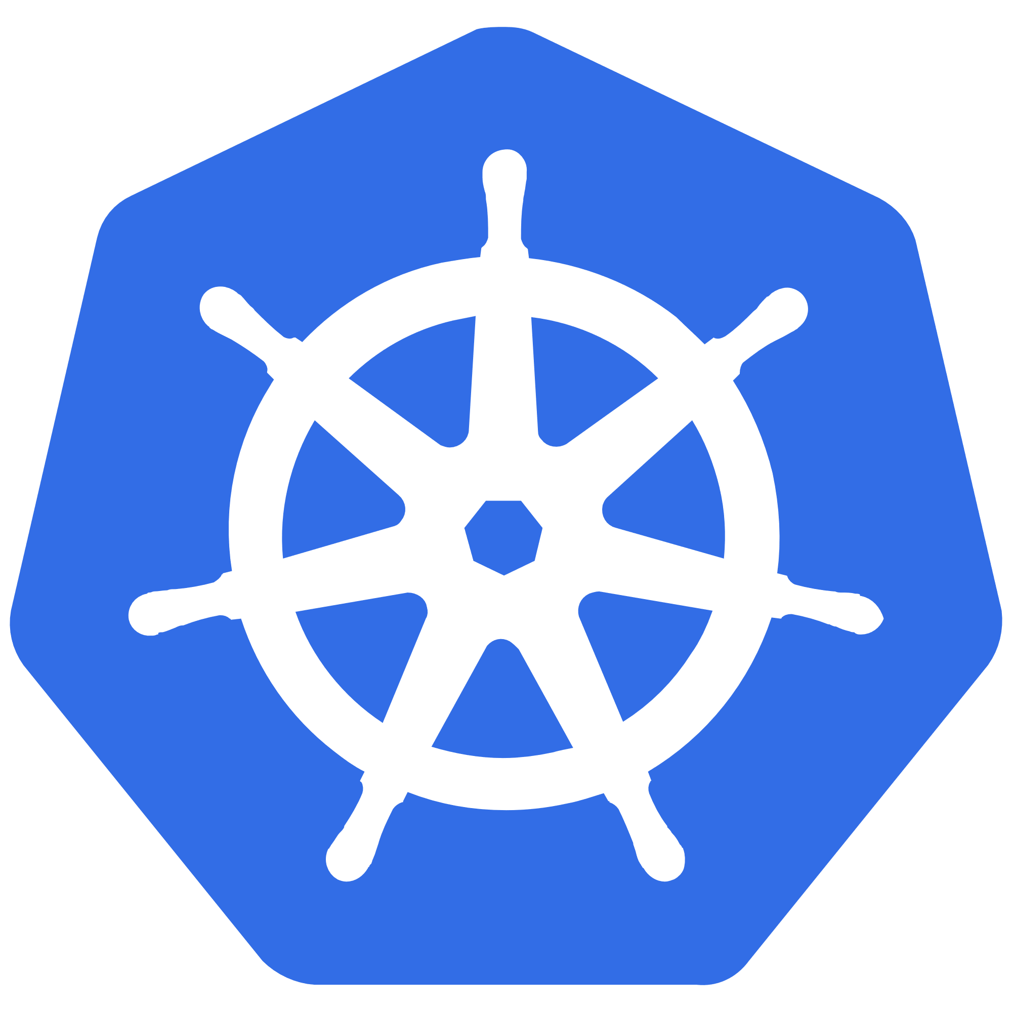


Operationalizing a Model
Container
Instances
App Service
HTTP
(REST)
Serverless
Functions
Kubernetes (AKS)
- Client App
- End User
- System / Code
- Other
Other Docker
Virtual Machines

Slide 3



HTTP Endpoint Consideration
Access
Encryption
Authentication
Internal vs Public
Rate limiting
Content Filtering (WAF)
CORS
TLS / HTTPS
Client Certificate
Mutual TLS
API Keys
Token based (OAuth)
HMAC
Basic Auth / Password
DON’T DO THIS

Slide 4

Kubernetes

Slide 5
Kubernetes Services – Illustrated
Allow virtual network access to one or more pods
label=myModel
kube-proxy
Service
Node 1
myModel
myModel
Service IP
selector: myModel port: 80 targetPort: 5000
Node 2
myModel
EXTERNAL
INTERNAL
LoadBalancer
Uses cloud provider to present an external load-balanced IP
ClusterIP
Internal virtual IP, only accessible by other pods/services

Slide 6







Letting People Call Your Model in Kubernetes
Example Architecture – Simple Operationalized Model
Basic ML Model
Running in 3 pods
Exposed with a ClusterIP Service
namespace: default
LoadBalancer
Azure
Load Balancer
model
model
External IP
Internal IP
DON’T DO THIS ( IN PRODUCTION )
model

Slide 7

Kubernertes Ingress – Reverse Proxy
External access for HTTP and HTTPS traffic
An Ingress allows you to route HTTP/HTTPS traffic to services based on URL and/or domain host name
Ingress Controller has a public IP and LoadBalancer service, it routes traffic to internal ClusterIP services
Various implementations of controllers are available
Ingress
/model-a/api
/model-b/api
pod
pod
Use an Ingress when you want to route HTTP(S) traffic into your workloads and pods

Slide 8







Ingress Shopping List
SSL/TLS Termination
Rate Limiting
JWT Validation
WAF
Traffic Routing
Distribution
Load Balancing
Observability
Service Discovery
… many others …

Slide 9

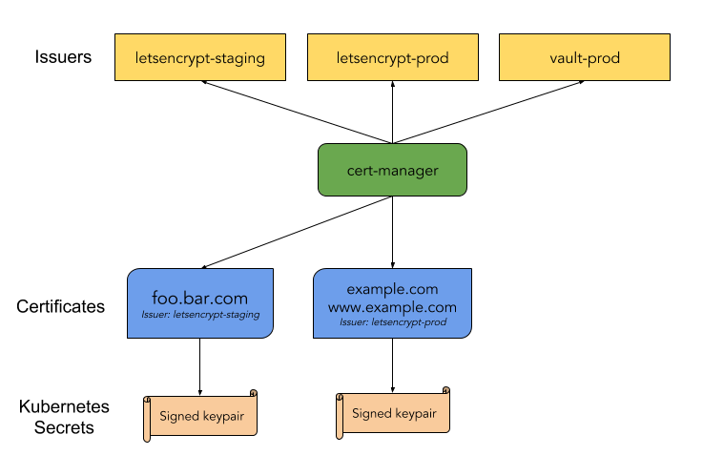
Cert Manager
Optional Addon – Automate issuing of TLS certificates
Ensures certificates are valid and up to date
Tightly coupled to Ingress, e.g. host rules
Renew certificates before expiry
Uses ACME issuers, i.e. Let’s Encrypt
github.com/jetstack/cert-manager
Issue TLS certs for HTTPS access to services & Ingress

Slide 10

Other Azure
Services

Slide 11



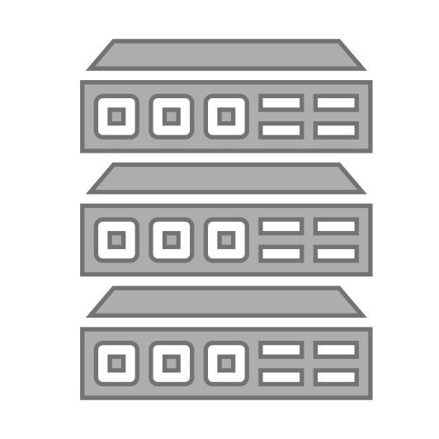


API Management
Discover
Learn
Get access
Try
Get help
SDKs and samples
1st and 3rd party apps
Abstract
Secure & protect
Manage lifecycle
Monitor & measure
Onboard developers
Monetize
Consume
Mediate
Publish
Developer Portal
Gateway
Azure portal
App developers
3rd Parties
API publishers
APIs hosted on and outside of Azure

Slide 12
API Management - Data Plane Security
API Keys
OAuth 2 & OpenID Connect
Client certificate
IP filter
External authorizer (custom)
Rate limits and quotas
API Keys
Mutual certificate (mTLS)
OAuth 2 & OpenID Connect
HTTP Basic
IP filter
Network security (VNET)
Developer portal
Gateway
YOUR APIS YOUR MODELS
Admin console
CONSUMERS CLIENTS

Slide 13




Keys vs. OAuth 2.0 (JWT – JSON Web Token)
 | KEY | OAuth JWT
Credential type | Bearer | Bearer
Granularity | All or nothing | Fine grained control
Sensitivity | Is a secret | Doesn’t contain secrets
Validation | Known | Signature
Expiration | External, ad hoc | Built-in, pre-defined
Subject | Developer or an app | End user or an app

Slide 14


Azure Front Door
Scalable and secure entry point for fast delivery of your global applications
Accelerate application performance
Smart health probes
URL-based routing
TLS termination
URL redirection
URL rewrite
Rules engine
WAF (Web Application Firewall)
Protect your API from attacks
Stop network and application layer attacks at the edge with Web Application Firewall and Azure DDoS Protection. Harden your service using Microsoft managed rule sets and author your own rules for custom protection of your app.

Slide 15



Putting It All Together – Global Deployment
Example end to end architecture
Azure Kubernetes Service (Europe)
API Management (Europe)
Certificate Issuer
model-a
AKS
Ingress TLS Cert
model-b
Rate Limiting
JWT Validation
Front Door
WAF
Global LB
model-a
AKS
OAuth Token Issuer
API Management (US)
Ingress TLS Cert
model-b
Azure Active Directory
Azure Kubernetes Service (US)

Slide 16
Summary
Don’t expose your APIs without considering security
The range of options is wide, but something is better than nothing :)
Don’t re-invent the wheel, let Azure Services do the heavy lifting
Securing Kubernetes is complex, but there’s tools to help
Q&A
@BenCodeGeek

